Slide 1







TIMETABLE PLANNER WEBSITE
AC4150E
-
152296
Concept
Video
From:
Group 3

Slide 2





Table of Contents!
Value in Design
Project Name and Value Proposition
Tasks
Problem/Solution Overview
Video Storyboard
Market Research
Concept Video

Slide 3

01
Project Name and Value Proposition

Slide 4


Name, Logo and Slogan
Name: PlanMate.
Logo: A pen drawing/writing timetable with initial letters of the app.
Slogan: “Your best mate in college”.
-> Fun, short and easy to remember.
-> Highlight support and companionship for students.

Slide 5
Name, Logo and Slogan
Value Proposition
Name: PlanMate.
Logo: A pen drawing/writing timetable with initial letters of the app.
Slogan: “Your best mate in college”.
-> Fun, short and easy to remember.
-> Highlight support and companionship for students.
Effortless timetable planning tailored for HUST students.

Slide 6
02
Problem/Solution Overview

Slide 7




Problem
Solution
HUST students face difficulties visualizing their timetables before course registration due to the lack of an official tool.
A user-friendly app that allows students to customize and visualize their timetables quickly, ensuring smooth course registration.
Primary Users
HUST students.

Slide 8
03
Market Research

Slide 9

CourseOff
Strengths
A scheduling tool for students that allows users to plan class schedules visually and avoid conflicts.
Simple and easy-to-use interface.
Supports many universities in the U.S.
Key Features
Weaknesses
Drag-and-drop interface for schedule planning.
Conflict detection.
Export schedules to PDF.
Lacks campus map integration.
Limited customization for preferences like days off.

Slide 10

UniTime
Strengths
An open-source academic scheduling solution used by universities for course timetabling, room assignments, and exams.
Powerful institutional-level features.
Highly configurable for different use cases.
Key Features
Weaknesses
Comprehensive scheduling tools for institutions.
Flexible customization options for timetable generation.
Overly complex for individual student use.
Not user-friendly for non-technical users.

Slide 11

Schedge
Strengths
A tool designed to help NYU students find and plan their classes based on availability and preferences.
Integrates directly with NYU’s systems.
Real-time updates ensure accurate scheduling.
Key Features
Weaknesses
Real-time class availability updates.
Easy search by department or course.
Only supports NYU students.
Lacks broader functionality like timetable sharing or campus maps.

Slide 12

Easy Schedule
Strengths
A lightweight timetable planner for students, focusing on simplicity and accessibility.
Simple setup and easy synchronization with calendars.
Key Features
Weaknesses
Straightforward manual input of classes.
Integration with Google Calendar for reminders.
No automated scheduling or export options.
Lacks advanced features like map integration.

Slide 13
Competitive Analysis
Automation of Scheduling | 4 | 3 | 4 | 0 | 5
Campus Map Integration | 0 | 0 | 0 | 0 | 5
Timetable Sharing | 0 | 0 | 0 | 0 | 5
Ease of Use | 5 | 2 | 4 | 5 | 5
Export Options | 5 | 3 | 4 | 2 | 5

Slide 14

04
Value in Design

Slide 15


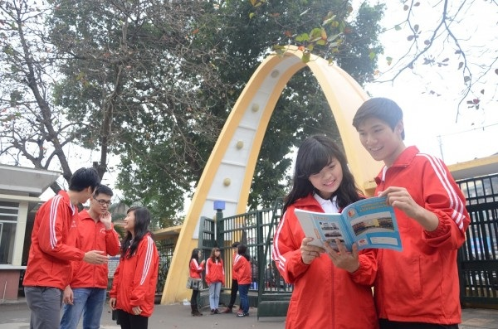
Stakeholders
Direct
HUST students.
System Developers.
School/University.
Indirect
Parents of Students.
Competitors (Other Scheduling Apps).
Student Clubs/Communities.

Slide 16


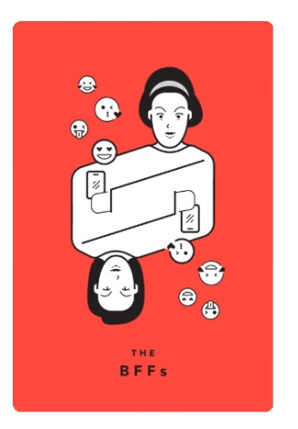

Ethical Implications

Slide 17
Ethical Implications

Slide 18
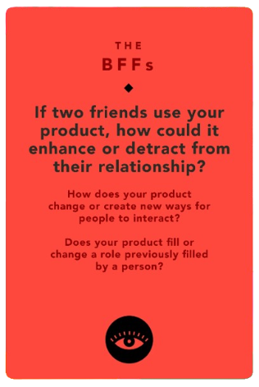
Ethical Implications

Slide 19
Ethical Implications

Slide 20
Ethical Implications
Enhances friendships by enabling trusted schedule sharing, making it easier to coordinate study or social activities.
Creates a new way to interact by automating timetable alignment, reducing the need for manual discussions.
Could detract if privacy concerns arise or the feature is misused.

Slide 21
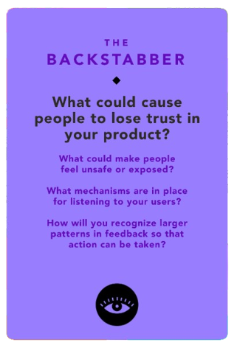
Ethical Implications

Slide 22
Ethical Implications

Slide 23
Ethical Implications
Trust issues could arise from data breaches or unauthorized schedule access.
Users may feel unsafe if schedules are accidentally shared or data handling lacks transparency.
Collect feedback via in-app surveys and dedicated support channels.
Analyze feedback trends to identify and prioritize common concerns for updates.

Slide 24
05
Tasks

Slide 25
Simple Tasks
Upload a timetable Excel file – Users select and upload the file with minimal interaction.
Export the personalized timetable to a PDF – A quick and straightforward action to save the timetable.

Slide 26
Moderate Tasks
Set preferences for timetable arrangement – Users select their preferred days, off-days, or time slots with guided interaction.
View the campus map with class locations – Requires users to navigate and search specific locations on the map.

Slide 27
Complex Tasks
Automatically generate and view a personalized timetable – Involves analyzing the uploaded file, preferences, and generating a custom schedule.
Share timetable with a best friend – Requires mutual verification, secure sharing, and privacy assurance between two users.

Slide 28
06
Video Storyboard

Slide 29
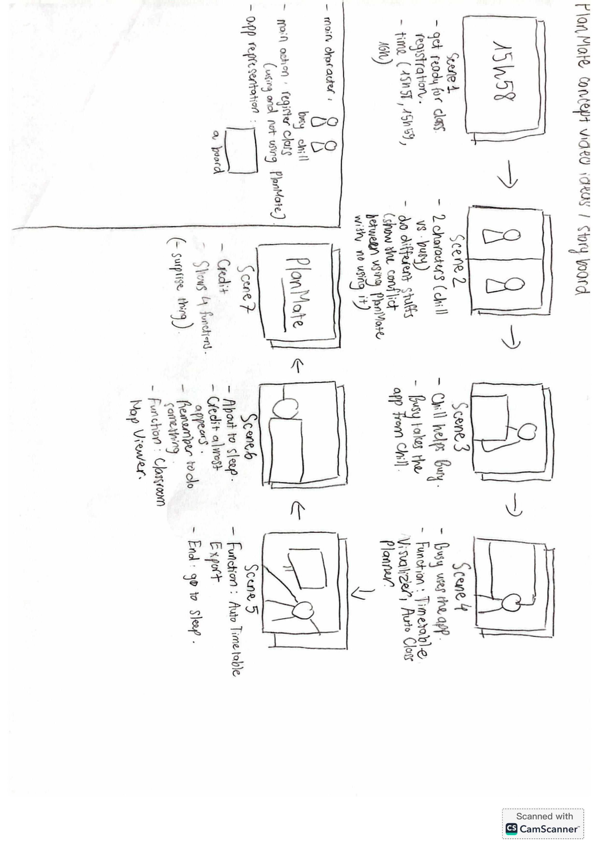
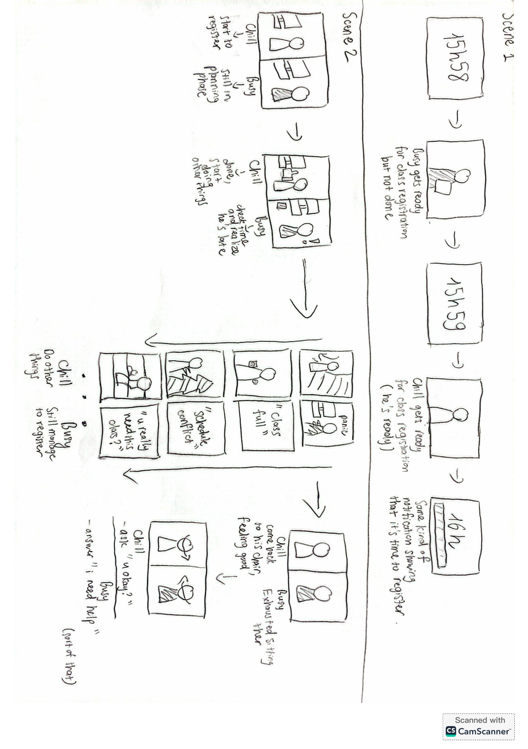

Slide 30
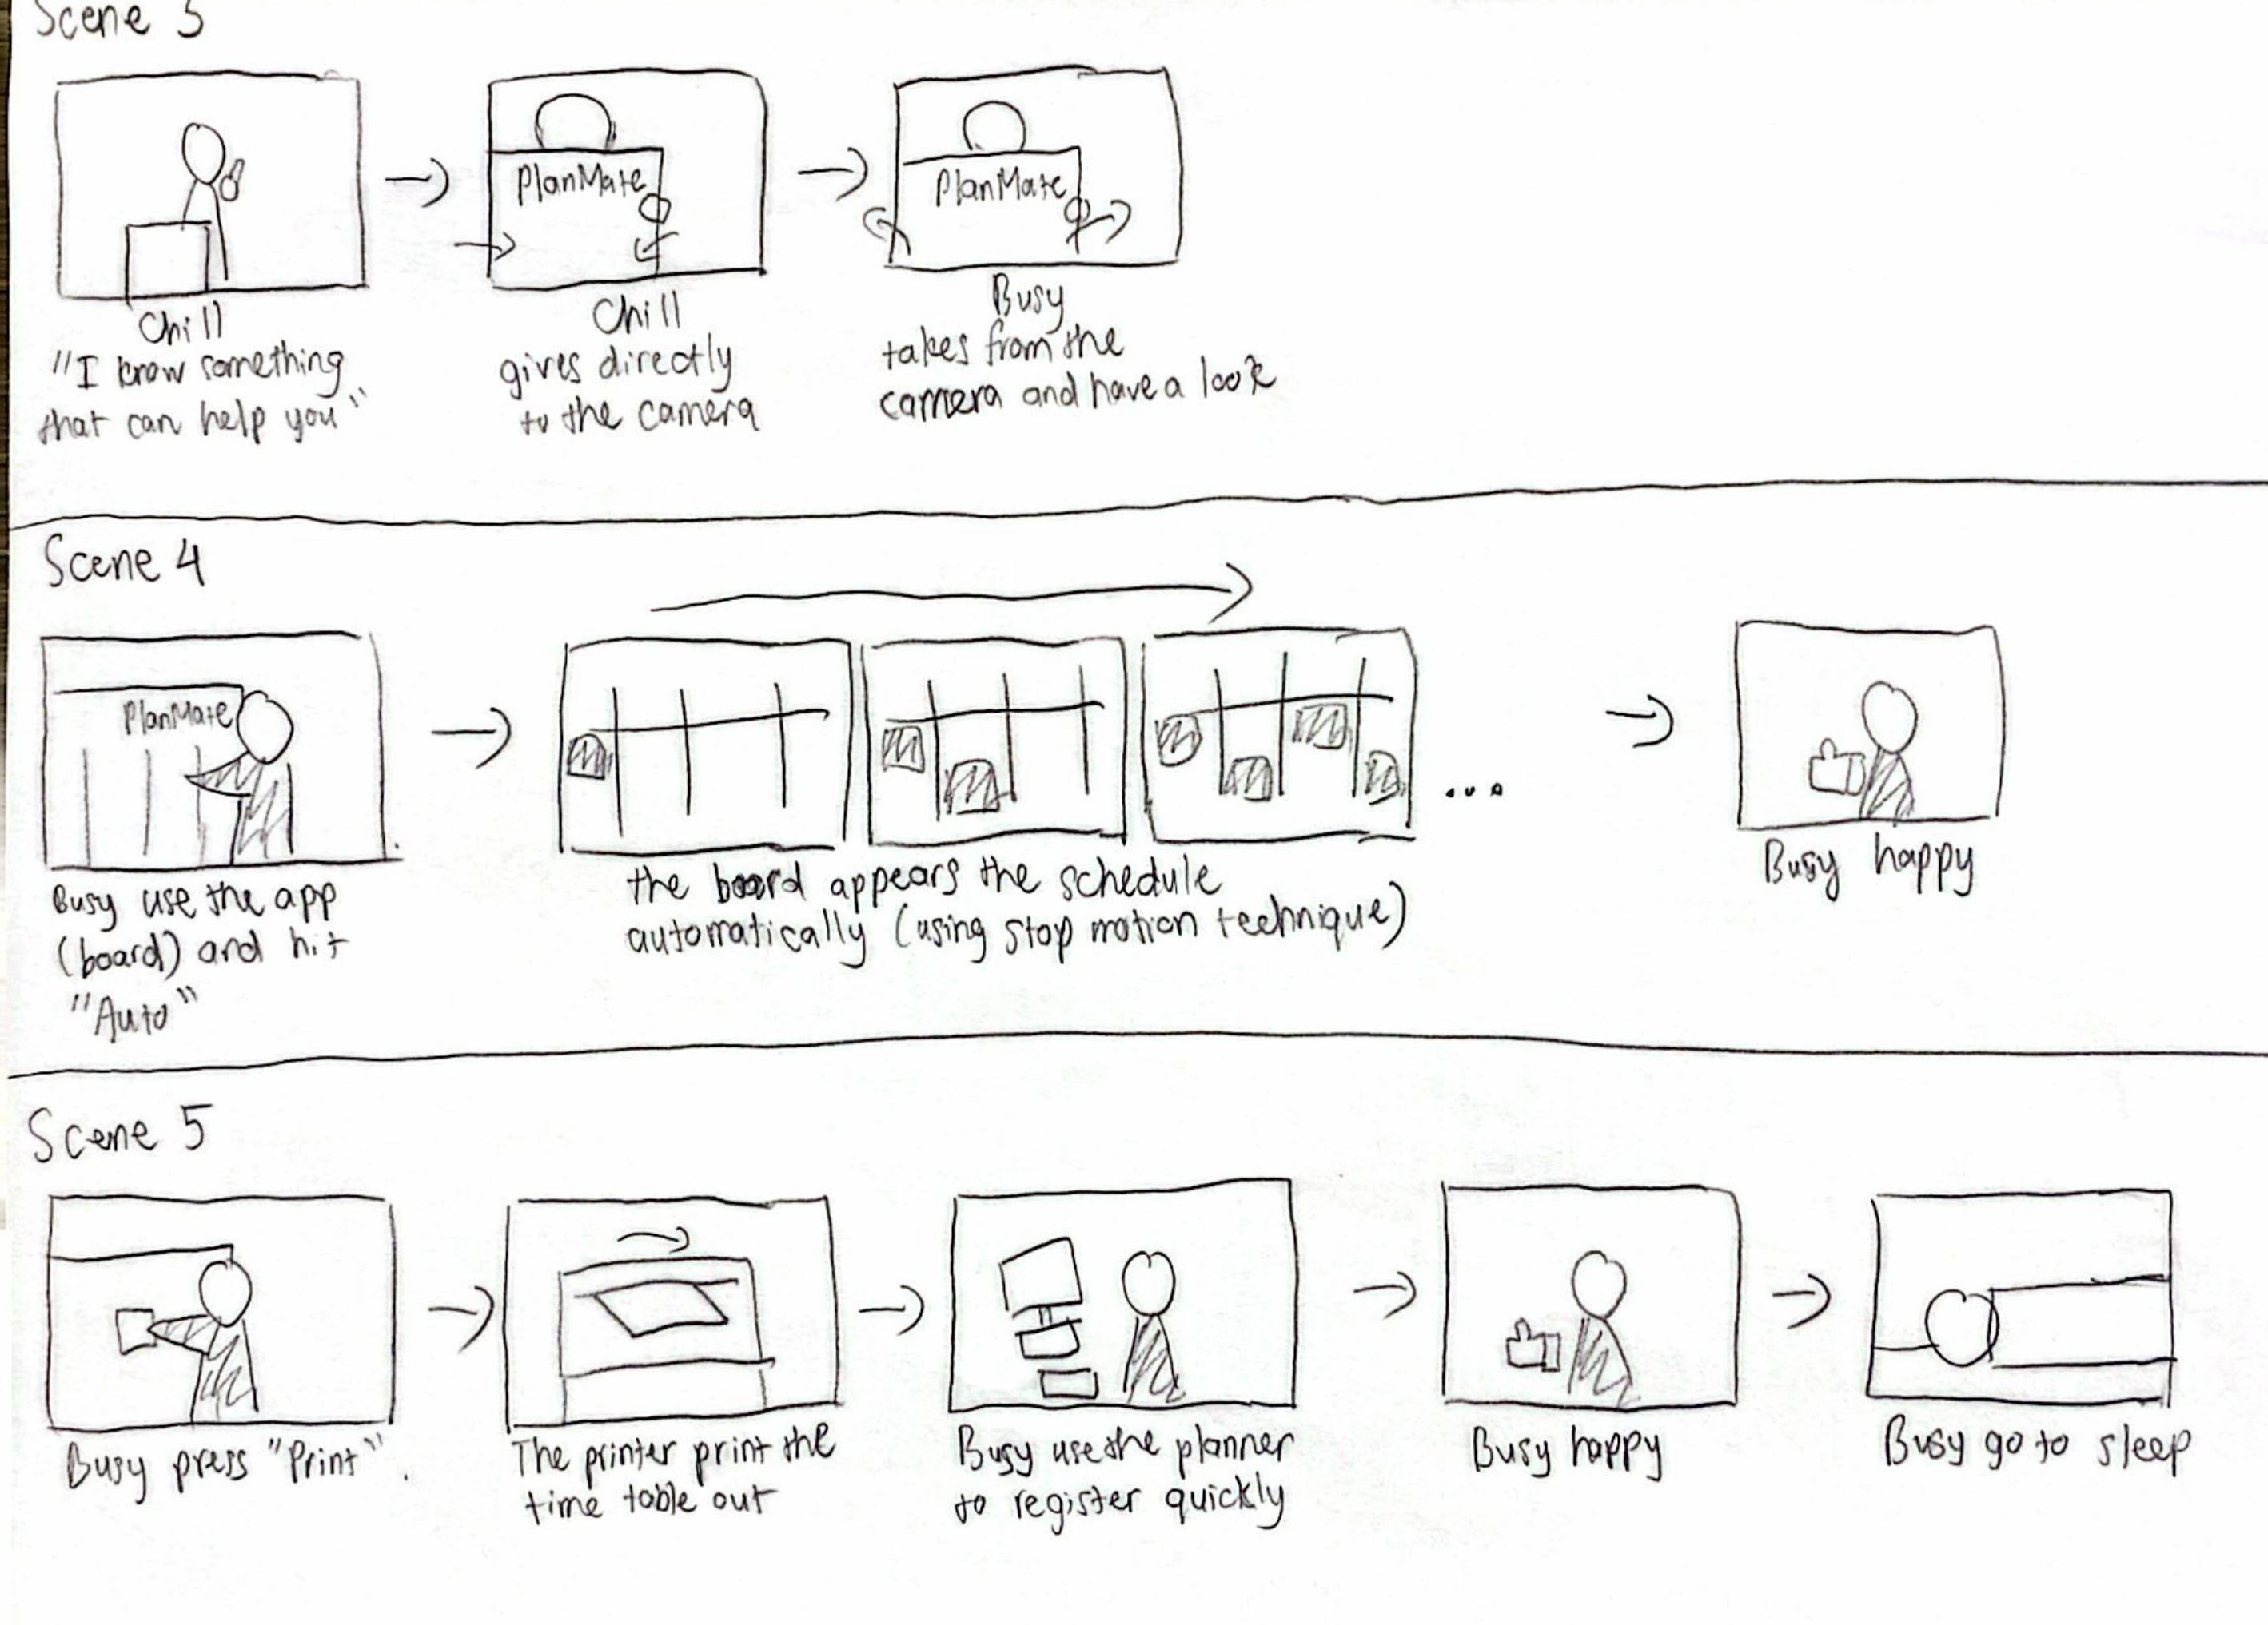

Slide 31
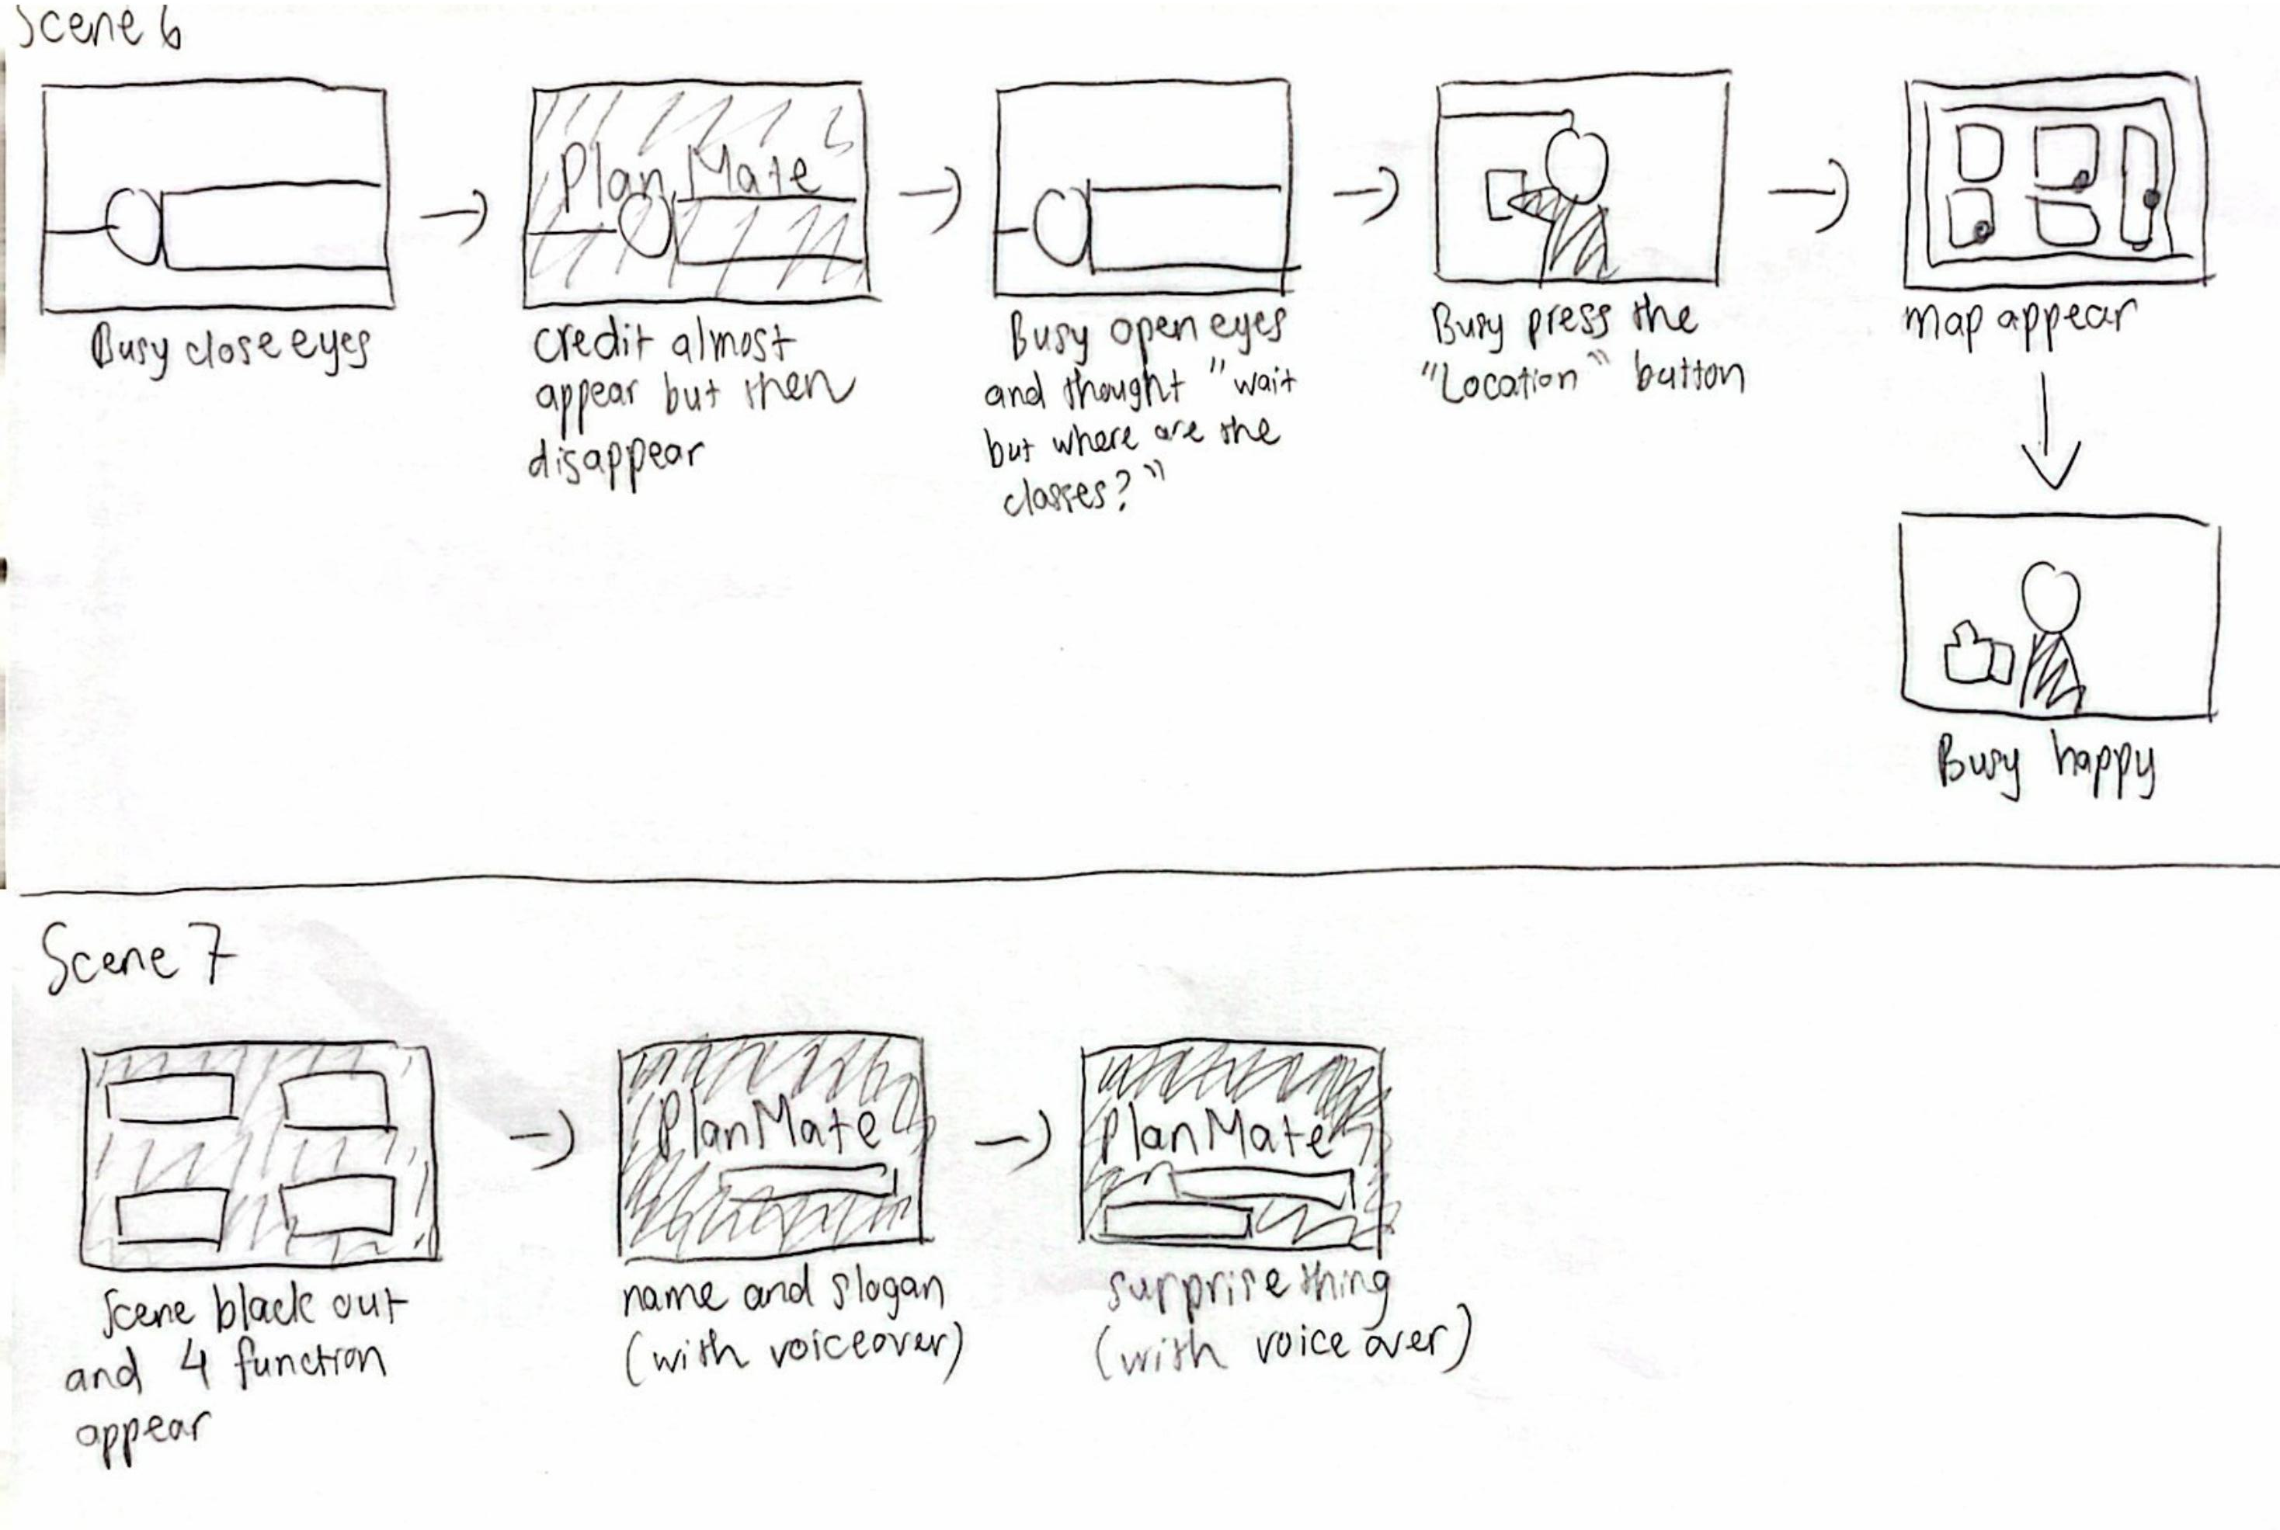

Slide 33
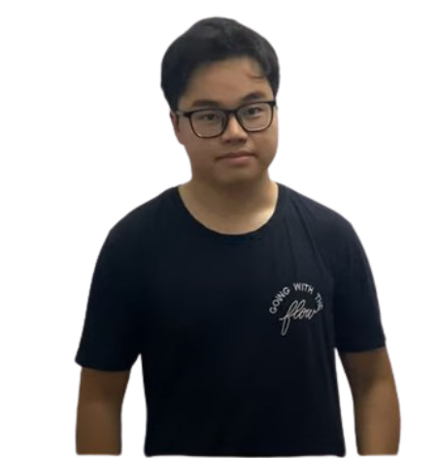
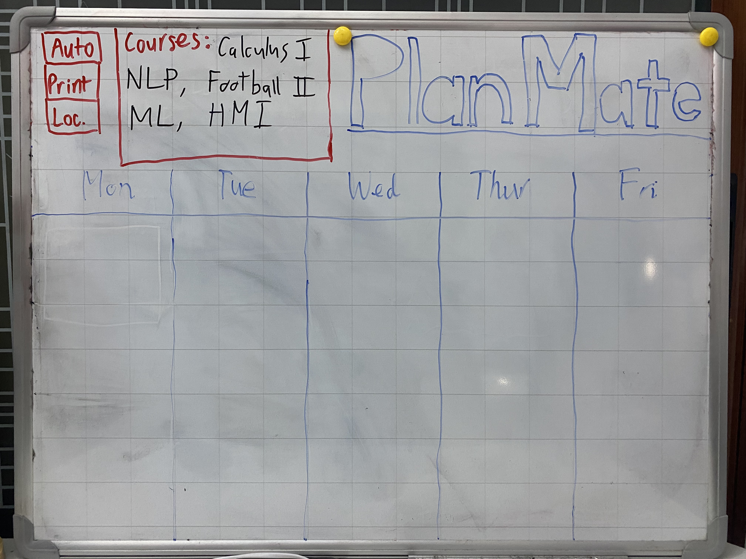
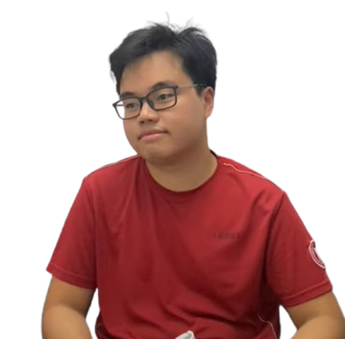
Split Screens
Overall Ideas
Characters
4 Functions Demonstration
Emphasize conflict between two sides.
Chill Guy
(Using PlanMate)
Busy Guy
(Not using PlanMate)
Timetable Visualizer.
Auto Class Planner.
Auto Timetable Export.
Classroom Map Viewer.

Slide 34
07
Concept Video

Slide 35
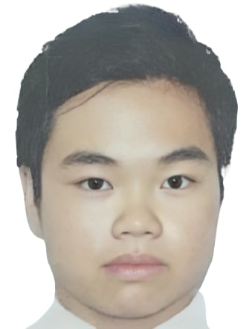


Have a look!
Have fun!
☺

Slide 36
TIMETABLE PLANNER WEBSITE
Thanks
Listening!
AC4150E
-
152296
Concept Video
For
From:
Group 3

